Slide 1
Customer churn prediction
Prachi Mehta (202318008)
Dhruvi Mehta (202318003)
Simran Dalvi (202318042)

Slide 2
Problem statement
Acquiring new customer is more costly than retaining current customer
Goal: In this project, we aim to leverage PySpark on the Sparkify music streaming dataset to construct a predictive model for anticipating customer churn. By analyzing user interactions including page visits, likes, dislikes, and cancellations, the model endeavors to forecast churn behavior accurately. Through this predictive framework, we seek to provide insights into user attrition patterns, enabling proactive measures to retain customers and enhance the overall user experience within the Sparkify platform.

Slide 3
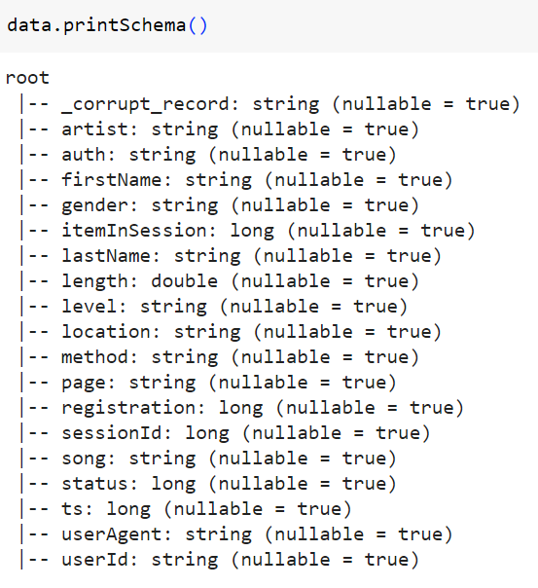
Data
Sparkify is an imaginary digital music service similar to Spotify.
The dataset contain 12GB of user interactions with this service.

Slide 4
Methodology
Feature Engineering
Cross Validation
Prediction
Data Cleaning
Remove null values from various columns
Extract features from user log data
User grid search cross validation for hyper-parameter tuning
Test the model using 20% of the dataset

Slide 5
Data preprocessing
Data selection
Unit conversion
Create churn label
Columns that were not significant to the modelling process will be dropped
Firstname
Lastname
Id_copy
userID was retained as it was used for feature engineering step.
Registration and TS were given in milliseconds.
These fields were converted to seconds by dividing the values by 1000.
Dataset only contains user log data used page column to identify churners:
Visiting cancellation confirmation page indicated a churned user
Creating a label column where 1 indicates a churned user and 0 indicated otherwise

Slide 6
Feature engineering
Meaningful data has to be created from the user log data that could be used by the prediction models.
The following features were used
Time since registration
Number of friends referred
Total songs listened to
Total songs liked
Total songs disliked
Number of songs in user playlist
Average songs played
Number of artists listened to
Number of user sessions logged
More features were used initially but discarded after observing less than 1% feature importance during training of models.

Slide 7
Modelling
Dataset will be split into 80-20 train test split
Grid search cross validation with three folds was used to built the following models
Gradient boosting trees
Random forests
Logistic regression
Support vector machine
Hybrid model

Slide 8
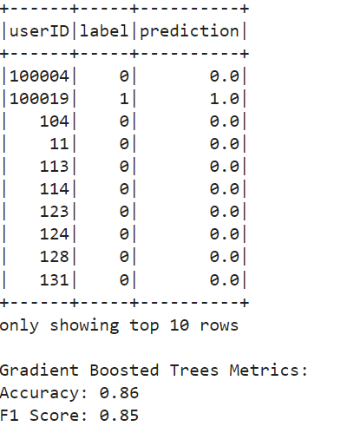
Gradient boosting trees
Gradient boosting trees is a method in machine learning where multiple decision trees are combined to improve predictions, focusing on correcting errors from previous trees for better accuracy.

Slide 9
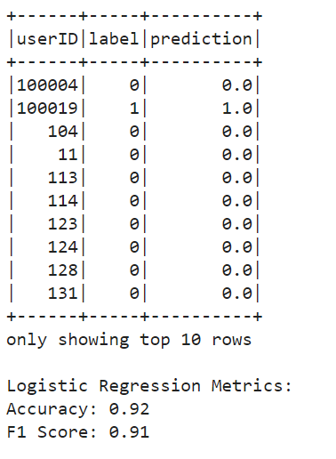
Logistic Regression
Logistic regression is a statistical method used for binary classification, predicting outcomes like whether a user will churn from a subscription service based on given features.

Slide 10
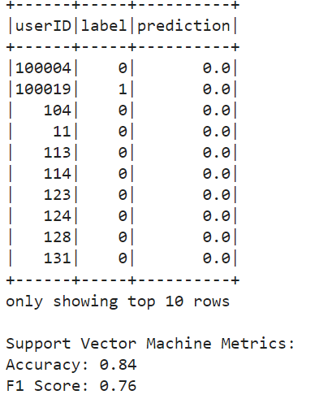
Support Vector Machine (SVM)
Support Vector Machine (SVM) is a machine learning algorithm for classification tasks, finding the best separation line (or hyperplane) between different classes in the data.

Slide 11
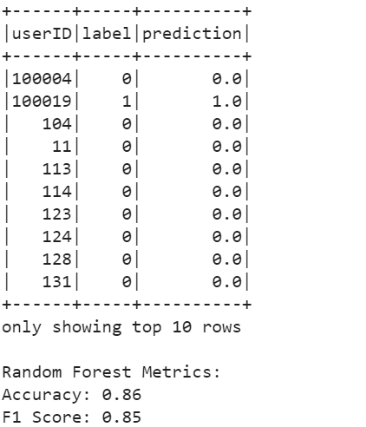
Random Forest Classifier
Random Forest Classifier is Machine learning Model that combines multiple decision trees to improve classification accuracy by voting on the most common prediction.

Slide 12
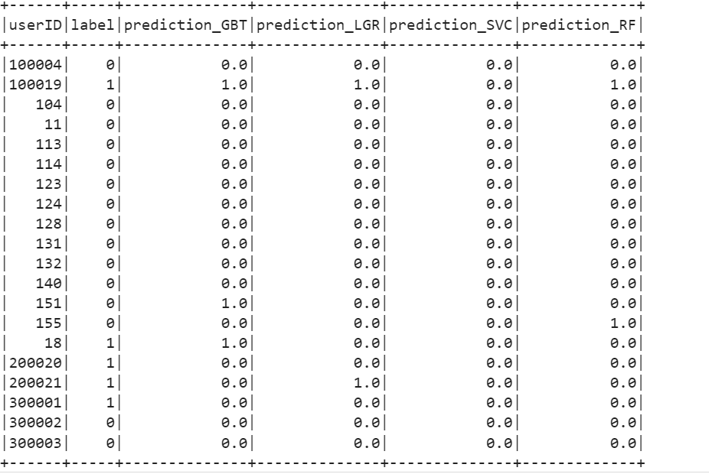
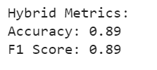
Hybrid model

Slide 13
CONCLUSISON
In conclusion, our project successfully utilized various user interaction features such as time since registration, number of friends referred, total songs listened to, liked, and disliked, along with playlist size, average songs played, number of artists listened to, and user session logs to predict customer churn.
Through thorough experimentation, logistic regression emerged as the optimal model for churn prediction in our context.
This model demonstrates promising accuracy and interpretability, providing valuable insights for proactive churn management strategies within the Sparkify music streaming platform.

Slide 14
references
(PDF) Computational Efficiency Analysis of Customer Churn Prediction Using Spark and Caret Random Forest Classifier (researchgate.net)
Customer churn prediction system: a machine learning approach | Computing (springer.com)

Slide 15
THANK YOU

